Slide 1

Identify, Investigate, Integrate, Inform: MRCs as Advisory Bodies
Clallam MRC, Chair LaTrisha Suggs
May 30th, 2025

Slide 2
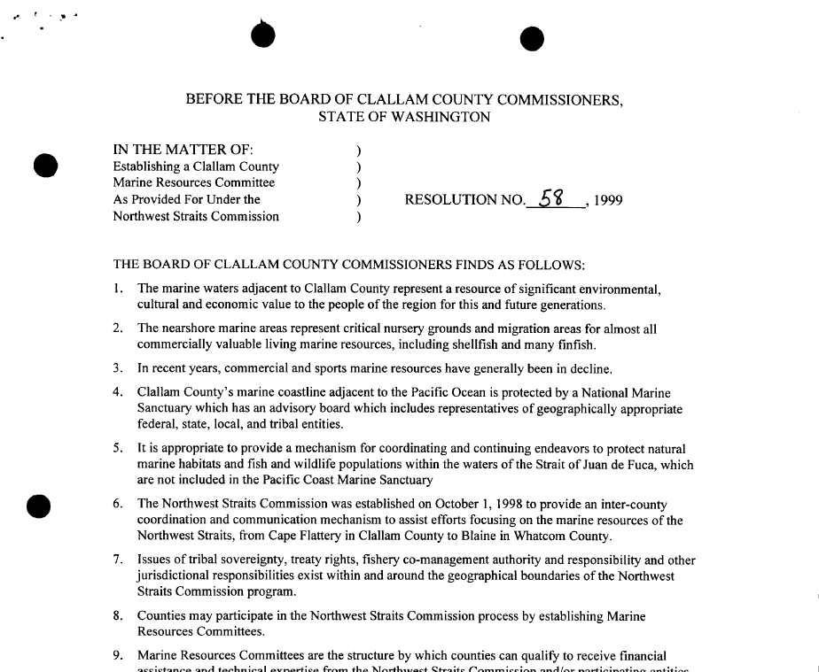
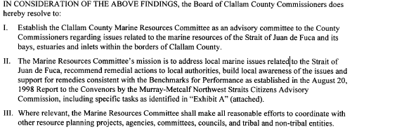
MRC ESTABLISHED AS AN ADVISORY BODY:
From Clallam MRC’s founding resolution 58-99:
“IN CONSIDERATION OF THE ABOVE FINDINGS, the Board of Clallam County Commissioners does hereby resolve to:
I. Establish the Clallam County Marine Resources Committee as an advisory committee to the County Commissioners regarding issues related to the marine resources of the Strait of Juan de Fuca and its bays, estuaries and inlets within the borders of Clallam County.”
Prior advisory process
  “reinvented the wheel” with each new concern

Slide 3


What is the Problem?
No formal Advisory Process had been created.
Chair of the CCMRC establishes Advisory sub-committee (September 2023).
  Goal: Develop a process for how the CCMRC would form and provide official comments.
The process needed to be a consistent process to enable CCMRC to effectively provide guidance and input to county government.
  The Developed Formal advisory process included:
    Identify: Issue or Action brought to CCMR
      Ex: Localized impact's of climate change, damaged caused by shoreline pollution or nonpoint pollution, or remedial actions to clean up affected area. Needs to have strong connection to nearshore.
Sponge Bob appoints sub-committee
    2) Investigate: Preliminary investigation of the issue or action​
        The subcommittee provide an investigative report to the full
        CCMRC, is there time and expertise to perform a full review,
        then continue to step 3.
      3) Integrate-A discussion report and recommendation is made
      and provided to full CCMRC
      4) Inform​- Path forward for providing advice to elected leaders.

Slide 4



Step 1: Identify the issue and nexus to marine resources and categorize as:
Local (county)
Regional (Salish Sea)
Worldwide
STOP If no strong nexus to marine resources is expected.
Step 2: Investigate proposed action or activity with regards to:
Scope
Location
Potentially involved parties
Permitting or decision-making process
Timeline
BOC/County position on issue
View full document:
STOP if project timeline will not provide MRC enough time to perform Step 3 activities
Step 3: Integrate: quantify likely positive and negative outcomes with regards to:
Environmental,
Socioeconomic, and
Cultural attributes
Step 4: Inform: decide how best to provide advice to county government
Briefing or letter to BOC
Public presentation (pro/con)
White paper (pro/con)
Response as private citizens
No response
Or clallamcountymrc.org/resources

Slide 5
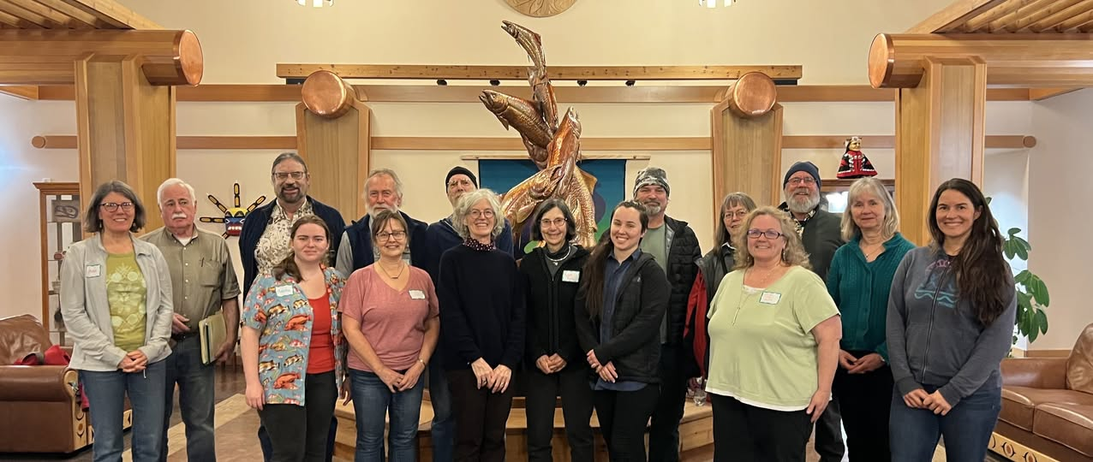
Implementation
Priority concerns for the marine environment requested by County Commissioners or DCD
Letter/Memo to Board of Commissioners for local shoreline concern
Newly formed Permanent Advisory Subcommittee will lead the process going forward
Engage with landowners through Education Opportunities, like the Shore Friendly workshops or beach walks.

